Slide 1


Computer Networks
Lectures (Chapter3)
Transport Layer
Subhan Ullah, PhD
subhan.ullah@nu.edu.pk
BS(Computer Science) Fall-2022

Slide 2
Transport layer: overview
Our goal:
understand principles behind transport layer services:
multiplexing, demultiplexing
reliable data transfer
flow control
congestion control
learn about Internet transport layer protocols:
UDP: connectionless transport
TCP: connection-oriented reliable transport
TCP congestion control

Slide 3

Transport layer: roadmap
Transport-layer services
Multiplexing and demultiplexing
Connectionless transport: UDP
Principles of reliable data transfer
Connection-oriented transport: TCP
Principles of congestion control
TCP congestion control
Evolution of transport-layer functionality

Slide 4

TCP connection management
before exchanging data, sender/receiver “handshake”:
agree to establish connection (each knowing the other willing to establish connection)
agree on connection parameters (e.g., starting seq #s)
application
application
connection state: ESTAB
connection variables:
seq # client-to-server
server-to-client
rcvBuffer size
at server,client
connection state: ESTAB
connection Variables:
seq # client-to-server
server-to-client
rcvBuffer size
at server,client
network
network
Socket clientSocket =
newSocket("hostname","port number");
Socket connectionSocket = welcomeSocket.accept();
Notes:
The other TCP topic we’ll want to consider here is that of “connection management”
The TCP sender and reciver have a number of pieces of shared state that they must establish before actually communication
FIRST theym ust both agree that they WANT to communicate with each other
Secondly there are connection parameters – the initial sequence number and the initial receiver-advertised bufferspace that they’ll want to agree on
This is done via a so-called handshake protocol – the client reaching our to the server, and the server answering back.
And before diving into the TCP handshake protocol, let’s first consider the problem of handshaking, of establishing shared state.

Slide 5


Agreeing to establish a connection
2-way handshake:
Q: will 2-way handshake always work in network?
variable delays
retransmitted messages (e.g. req_conn(x)) due to message loss
message reordering
can’t “see” other side
Let’s talk
ESTAB
OK
ESTAB
choose x
req_conn(x)
ESTAB
acc_conn(x)
ESTAB
Notes:
Here’s an example of a two way handshake. Alice reaches out to Bob and say’s “let’s talk” and Bob says OK, and they start their conversation
For a network protocol, the equivalent protocol would be a client sending a “request connection” message saying ”let’s talk, the initial sequence number is x”
And the server would respond with a message ”I accept your connect x”
And the question we want to ask ourselves is <talk through>
Will this work? Let’s look at a few scenarios…

Slide 6

2-way handshake scenarios
choose x
req_conn(x)
ESTAB
acc_conn(x)
ESTAB
data(x+1)
accept
data(x+1)
ACK(x+1)
connection
x completes
No problem!

Slide 7

2-way handshake scenarios
choose x
req_conn(x)
ESTAB
retransmit
req_conn(x)
acc_conn(x)
ESTAB
req_conn(x)
connection
x completes
client terminates
server
forgets x
ESTAB
acc_conn(x)
Problem: half open connection! (no client)

Slide 8
2-way handshake scenarios
choose x
req_conn(x)
ESTAB
retransmit
req_conn(x)
acc_conn(x)
ESTAB
data(x+1)
accept
data(x+1)
retransmit
data(x+1)
connection
x completes
client terminates
server
forgets x
req_conn(x)
ESTAB
data(x+1)
accept
data(x+1)
Problem: dup data
accepted!

Slide 9
TCP 3-way handshake
Server state
Client state
serverSocket = socket(AF_INET,SOCK_STREAM)
serverSocket.bind((‘’,serverPort))
serverSocket.listen(1)
connectionSocket, addr = serverSocket.accept()
clientSocket = socket(AF_INET, SOCK_STREAM)
LISTEN
clientSocket.connect((serverName,serverPort))
LISTEN
choose init seq num, x
send TCP SYN msg
SYNSENT
SYNbit=1, Seq=x
choose init seq num, y
send TCP SYNACK
msg, acking SYN
SYN RCVD
SYNbit=1, Seq=y
ACKbit=1; ACKnum=x+1
received SYNACK(x)
indicates server is live;
send ACK for SYNACK;
this segment may contain
client-to-server data
ESTAB
ACKbit=1, ACKnum=y+1
received ACK(y)
indicates client is live
ESTAB
Notes:
TCP’s three way handshake, that operates as follows
Let’s say the client and server both create a TCP socket as we learned about in Chapter 2 and enter the LISTEN state
The client then connects to the server sending a SYN message with a sequence number x (SYN Message is an TCP Segment with SYN but set in the header – you might want to go back and review the TCP segment format!)
The server is waiting for a connection, and receives the SYN message enters the SYN received state (NOT the established state and sends a SYN ACK message back.
Finally the client sends an ACK message to the server, and when the server receiver this enters the ESTABLished state. This is when the application process would see the return from the wait on the socket accept() call

Slide 10
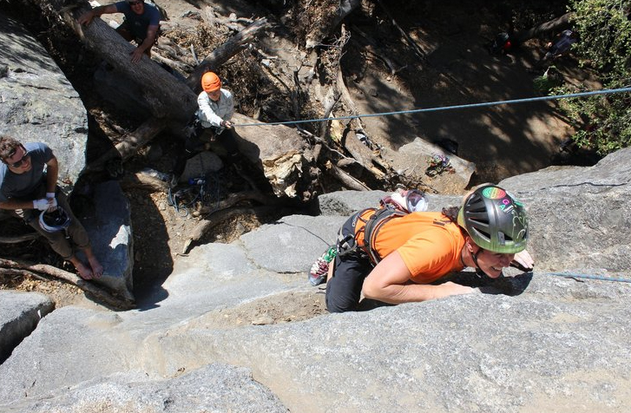
A human 3-way handshake protocol
1. On belay?
2. Belay on.
3. Climbing.
Notes:
As usual, there’s a human protocol analogy to the three way handshake, and I still remember thinking about this clinging for my life while climbing up a rockface
When you want start climbing you first say ON BELOW (meaning ARE YOU READY WITH MY SAFETY ROPE)
THE BELYER (server) responds BELAY ON (that lets you know the belayer is ready for you)
And then you say CLIMING
It’s amazing what can pass through your head when your clinging for your life o a

Slide 11
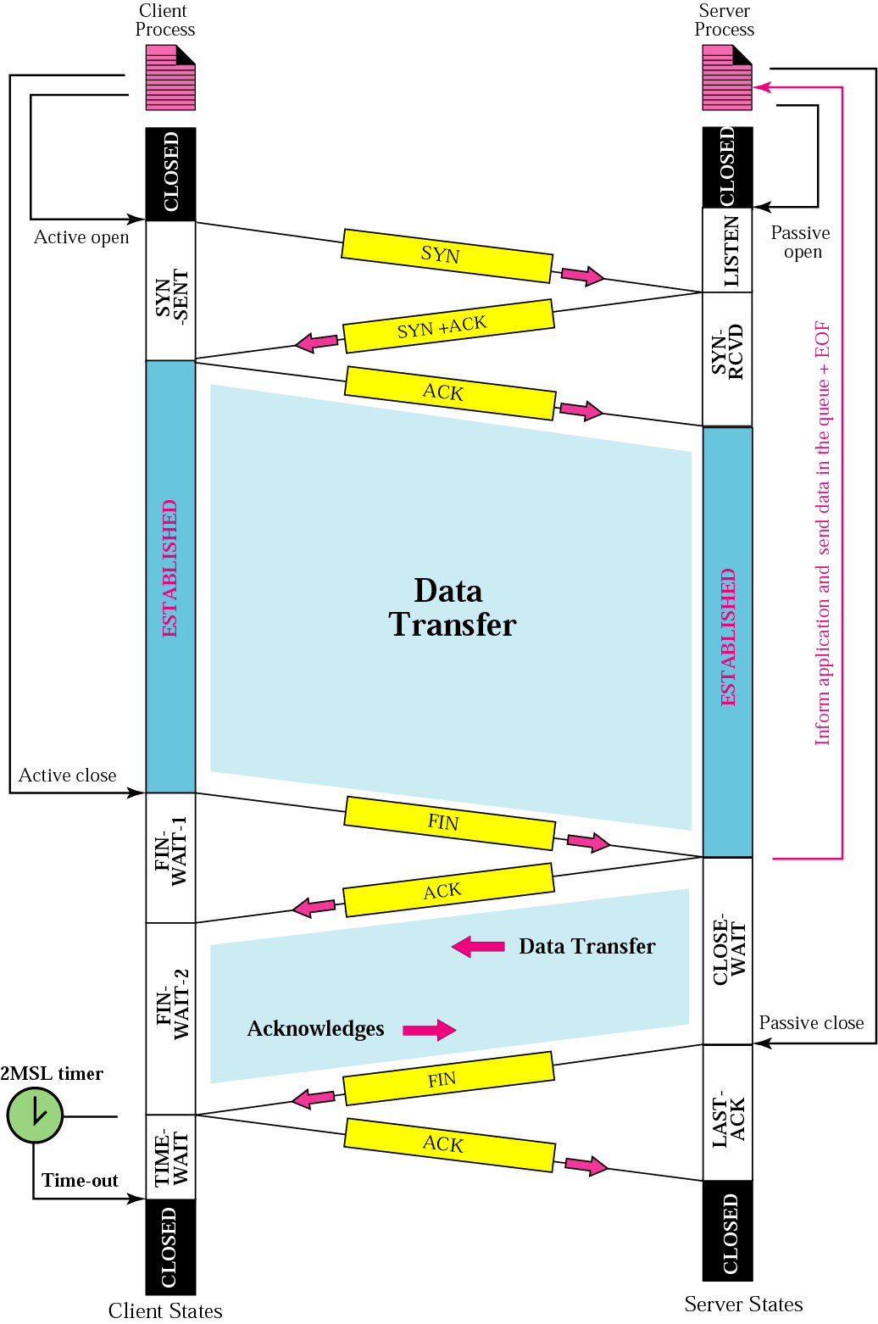
Closing a TCP connection
client, server each close their side of connection
send TCP segment with FIN bit = 1
respond to received FIN with ACK
on receiving FIN, ACK can be combined with own FIN
simultaneous FIN exchanges can be handled
Notes:
All good things must come to an end, and that’s true for a TCP connection as well.
And of course there’s a protocol for one side to gracefully close of a TCP connection using a FIN message, to which the other side sends a FINACK message and waits around a bit to respond to any retransmitted FIN messages before timing out.

Slide 12
Closing a TCP connection
client state
server state
ESTAB
ESTAB
clientSocket.close()
FIN_WAIT_1
can no longer
send but can
receive data
FINbit=1, seq=x
CLOSE_WAIT
ACKbit=1; ACKnum=x+1
can still
send data
FIN_WAIT_2
wait for server
close
LAST_ACK
FINbit=1, seq=y
TIMED_WAIT
can no longer
send data
ACKbit=1; ACKnum=y+1
timed wait
for 2*max
segment lifetime
CLOSED
CLOSED

Slide 13
Chapter 3: roadmap
Transport-layer services
Multiplexing and demultiplexing
Connectionless transport: UDP
Principles of reliable data transfer
Connection-oriented transport: TCP
Principles of congestion control
TCP congestion control
Evolution of transport-layer functionality
Notes:
D topic covered: date: 25/11/2021

Slide 14
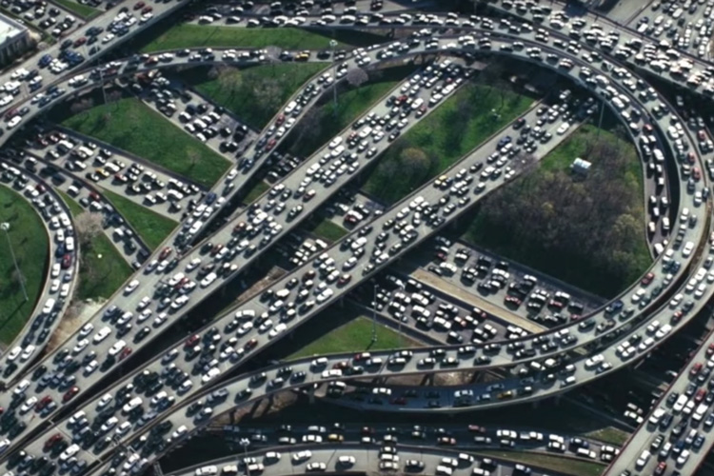

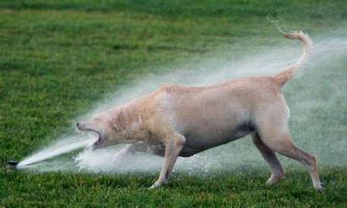
Principles of congestion control
Congestion:
informally: “too many sources sending too much data too fast for network to handle”
manifestations:
long delays (queueing in router buffers)
packet loss (buffer overflow at routers)
different from flow control!
congestion control: too many senders, sending too fast
a top-10 problem!
flow control: one sender too fast for one receiver

Slide 15
Flow vs. Congestion Control

Slide 16
Causes/costs of congestion: scenario 1
original data: λ_{in}
throughput: λ_{out}
Simplest scenario:
Host A
one router, infinite buffers
input, output link capacity: R
infinite shared output link buffers
two flows
R
R
no retransmissions needed
Host B
R/2
Q: What happens as arrival rate λ_{in} approaches R/2?
λ_{out}
delay
throughput:
λ_{in}
R/2
λ_{in}
R/2
maximum per-connection throughput: R/2
large delays as arrival rate λ_{in} approaches capacity
R/2
Notes:
Ideal case. ..

Slide 17
Causes/costs of congestion: scenario 2
one router, finite buffers
sender retransmits lost, timed-out packet
application-layer input = application-layer output: λ_{in} = λ_{out}
transport-layer input includes retransmissions : λ’_{in} λ_{in}
Host A
λ_{in} : original data
λ'_{in}: original data, plus retransmitted data
λ_{out}
R
R
Host B
finite shared output link buffers

Slide 18
Causes/costs of congestion: scenario 2
Idealization: perfect knowledge
sender sends only when router buffers available
R/2
λ_{out}
throughput:
Host A
λ_{in} : original data
λ_{in}
copy
λ'_{in}: original data, plus retransmitted data
λ_{out}
R/2
free buffer space!
R
R
Host B
finite shared output link buffers

Slide 19
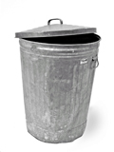
Causes/costs of congestion: scenario 2
Idealization: some perfect knowledge
packets can be lost (dropped at router) due to full buffers
sender knows when packet has been dropped: only resends if packet known to be lost
Host A
λ_{in} : original data
copy
λ'_{in}: original data, plus retransmitted data
no buffer space!
R
R
Host B
finite shared output link buffers

Slide 20
Causes/costs of congestion: scenario 2
Idealization: some perfect knowledge
packets can be lost (dropped at router) due to full buffers
sender knows when packet has been dropped: only resends if packet known to be lost
R/2
λ_{out}
“wasted” capacity due to retransmissions
when sending at R/2, some packets are needed retransmissions
throughput:
Host A
λ_{in} : original data
λ_{in}
λ'_{in}: original data, plus retransmitted data
R/2
free buffer space!
R
R
Host B
finite shared output link buffers

Slide 21


Causes/costs of congestion: scenario 2
Realistic scenario: un-needed duplicates
packets can be lost, dropped at router due to full buffers – requiring retransmissions
but sender times can time out prematurely, sending two copies, both of which are delivered
R/2
λ_{out}
“wasted” capacity due to un-needed retransmissions
throughput:
when sending at R/2, some packets are retransmissions, including needed and un-needed duplicates, that are delivered!
Host A
λ_{in} : original data
λ_{in}
copy
λ'_{in}: original data, plus retransmitted data
R/2
timeout
free buffer space!
R
R
Host B
finite shared output link buffers

Slide 22
Causes/costs of congestion: scenario 2
Realistic scenario: un-needed duplicates
packets can be lost, dropped at router due to full buffers – requiring retransmissions
but sender times can time out prematurely, sending two copies, both of which are delivered
R/2
λ_{out}
“wasted” capacity due to un-needed retransmissions
throughput:
when sending at R/2, some packets are retransmissions, including needed and un-needed duplicates, that are delivered!
λ_{in}
R/2
“costs” of congestion:
more work (retransmission) for given receiver throughput
unneeded retransmissions: link carries multiple copies of a packet
decreasing maximum achievable throughput

Slide 23
Causes/costs of congestion: scenario 3
four senders
multi-hop paths
timeout/retransmit
Q: what happens as λ_{in} and λ_{in}’ increase ?
A: as red λ_{in}’ increases, all arriving blue pkts at upper queue are dropped, blue throughput g 0
Host A
λ_{in} : original data
λ'_{in}: original data, plus retransmitted data
Host B
finite shared output link buffers
Host D
λ_{out}
Host C

Slide 24
Causes/costs of congestion: scenario 3
R/2
λ_{out}
λ_{in}’
R/2
another “cost” of congestion:
when packet dropped, any upstream transmission capacity and buffering used for that packet was wasted!

Slide 25
Causes/costs of congestion: insights
throughput can never exceed capacity
delay increases as capacity approached
loss/retransmission decreases effective throughput
un-needed duplicates further decreases effective throughput
upstream transmission capacity / buffering wasted for packets lost downstream

Slide 26
Approaches towards congestion control
End-end congestion control:
no explicit feedback from network
congestion inferred from observed loss, delay
ACKs
data
data
ACKs
approach taken by TCP

Slide 27
Approaches towards congestion control
Network-assisted congestion control:
routers provide direct feedback to sending/receiving hosts with flows passing through congested router
may indicate congestion level or explicitly set sending rate
explicit congestion info
ACKs
data
data
ACKs
TCP ECN, ATM, DECbit protocols

Slide 28


Thank You All
☺
?
A note on the origin of these ppt slides:
All material copyright 1996-2020 J.F Kurose and K.W. Ross, All Rights Reserved
These slides are freely provided by the book authors and it represents a lot of work on their part. We would like to thank J.F Kurose and K.W. Ross.
Transport Layer: 3-150
Notes:
Section F and G ended

